Slide 1

Object based video Summarization
Under the guidance of - Prof. Anupam Agrawal
Presentation by Group B4:-
Tavva Srinivas IIT2022232
Rohit Patil IIT2022234
Sahil Sonawane IIT2022236
Himanshu Raj IIT2022237
Ashutosh Sahu IIT2022238
Ankit Kumar IIT2022256
Disha Soni IIT2022260
Aakash Dhoriyani IIT2022264

Slide 2
Content
Introduction
Literature Survey
Best Results
Challenges
Proposed Methodology
Dataset(Test data)
Timeline
References

Slide 3
Introduction
Stated Problem : Object Based Video Summarization
Motivation : Aims to efficiently summarize videos by identifying and focusing on key objects, reducing data size while retaining essential content
Challenges :
High Processing Power
Limited Accuracy
Loss of Important Information
Time-Consuming Analysis
Vagueness in Summaries

Slide 4
Literature Survey
An Optimized Deep Learning Method for Video Summarization Based on the User Object of Interest | International Journal of Advanced Computer Science and Applications, Vol. 14, No. 10, 2023 | TvSumMe and TVSum datasets | Merits - Customizable: Summarizes videos based on specific User Objects of Interest (UOoI), like cars or people. High Performance: 98.7% accuracy on SumMe dataset and 97.5% on a self-created dataset, with summarization rates of 93.5% and 67.3%, respectively.
Object Detection based Approach for an Efficient Video Summarization with System Statistics over Cloud | 2022 IEEE 9th Uttar Pradesh Section International Conference on Electrical, Electronics and Computer Engineering (UPCON) | TvSumMe and TVSum datasets | Merits:This video summarization method efficiently reduces video length, retaining key frames with high accuracy and minimal resources. It uses fast YOLO models for object detection.
Object-Based Video Archive Summarization | 2023 International Mobile, Intelligent, and Ubiquitous Computing Conference (MIUCC) | TvSumMe and TVSum datasets | Merits:This system efficiently summarizes long surveillance videos by focusing on user-specified objects, using YOLOv8 for detection and centroid tracking for tracking. Keyframes are extracted to retain essential content, significantly reducing video length and size
An Effective Video Summarization Framework Based on the Object of Interest Using Deep Learning | Hindawi Mathematical Problems in Engineering Volume 2022, Article ID 7453744, 25 pages | TvSumMe and TVSum datasets | Merits:The proposed framework offers an efficient and accurate video summarization approach by focusing on user-specified Objects of Interest (OoI) with high accuracy (99.6% on VSUMM, 99.9% on TVSum) and real-time processing speed (45 fps).
Image Conditioned Keyframe-Based Video Summarization Using Object Detection | Department of Computer Engineering and Applications, GLA University, Mathura, India | TvSumMe and TVSum datasets | The paper presents a personalized video summarization method using an image-based query to select keyframes with minimal redundancy. It improves F1-scores by 11.01% and speeds up processing by 7.81 times on the UTE dataset.

Slide 5
Paper - 1
An Optimized Deep Learning Method for Video Summarization Based on the User Object of Interest Hafiz Burhan Ul Haq, Watcharapan Suwansantisuk, Kosin Chamnongthai, International Journal of Advanced Computer Science and Applications, vol. 14, no. 10, pp. 244-256, 2023.
Methodology:
Model: YOLOv3 , localization of User Object of Interest (UOoI) in video frames
Approach: YOLO v3 detects UOoI , Key Frame Extraction (Summarises the video by selecting only frames with UOoI, discarding irrelevant content.)
Evaluation:
Tested on SumMe and custom datasets.
Achieved high performance: 98.7% accuracy on SumMe, 97.5% on custom dataset.
Performance metrics: precision, recall, F1-score.
Scope:
Suitable for video surveillance, personal video summarization, and content indexing.
Offers time and resource-efficient summarization for security and monitoring applications.

Slide 6
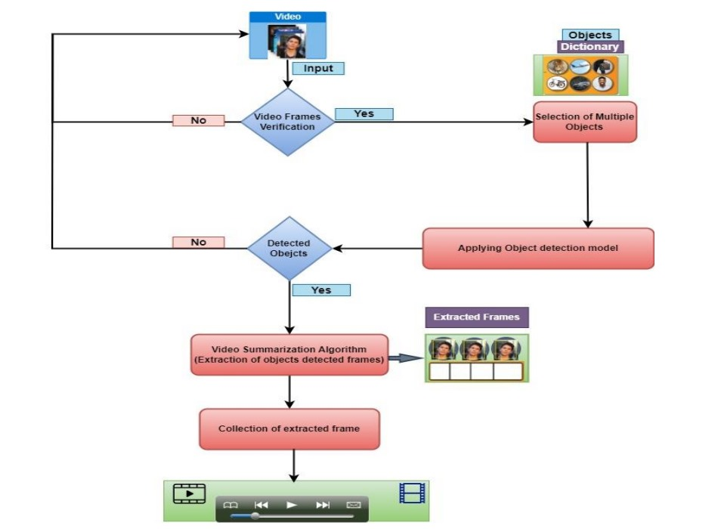
Model Architecture
[1]

Slide 7
Paper-2
Alok Negi, Krishan Kumar, Parul Saini, and Shamal Kashid, "Object detection based approach for an efficient video summarization with system statistics over cloud," IEEE 9th Uttar Pradesh Section International Conference on Electrical, Electronics and Computer Engineering (UPCON), vol. 2022, Article ID 9986376, pp. 1-6, 2022.
Methodology:
Model: Efficient video summarization via object detection.
Approach: Uses YOLOv5 for object detection to identify keyframes that summarize the video efficiently.
Evaluation: Outperforms baseline models on SumMe dataset, consisting of 25 videos (1-5 minutes).
Scope: Focuses on cloud-based system monitoring, analyzing performance metrics like processing time, memory, and CPU usage.

Slide 8
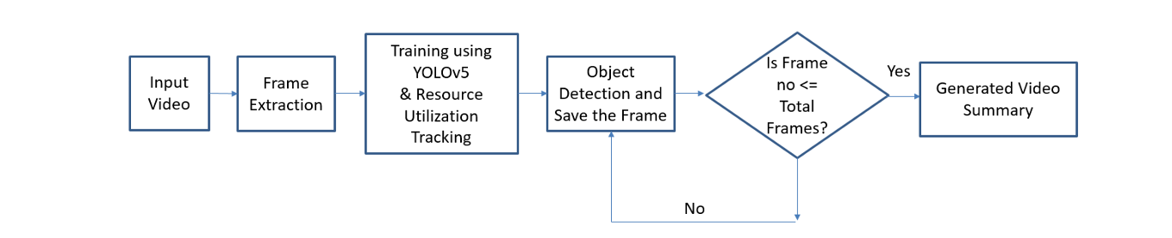
Model Architecture
[2]

Slide 9
Paper - 3
Object-Based Video Archive Summarization
H. Y. Adel, R. M. Elmasry, and M. A.-M. Salem, "Object-Based Video Archive Summarization," Media Engineering and Technology, German University in Cairo, Cairo, Egypt.
Methodology:
Model:The paper presents a hybrid framework combining traditional computer vision and deep learning. Faster R-CNN is used for object detection, followed by Kalman filter and Hungarian algorithm for object tracking..
Approach: The framework summarizes video archives by focusing on key objects, reducing redundant frames.
Evaluation: The system was evaluated using a custom dataset consisting of archived videos having 92.5% Precision , 90.1% Recall , 91.3% F1-Score .The video length was reduced by an average of 70% while maintaining high relevance, as measured by user satisfaction surveys and object detection consistency.
Scope: video archiving, surveillance, and video content management

Slide 10
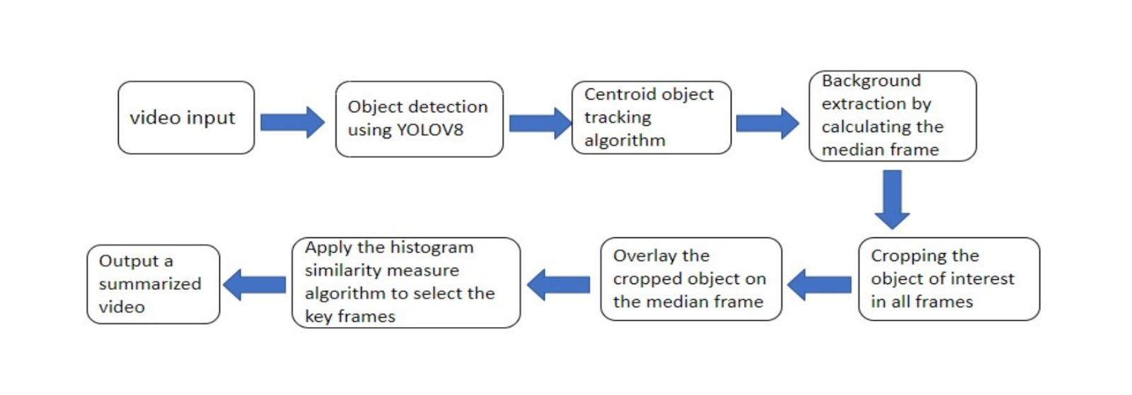
Model Architecture
[3]

Slide 11
Paper - 4
Neeraj Baghel, Suresh C. Raikwar, and Charul Bhatnagar "Image Conditioned Keyframe-Based Video Summarization Using Object Detection" Unpublished manuscript, 2020.
Methodology:
Model: Video summarization using image-conditioned object detection.
Approach: A mathematical model minimizes redundancy by using similarity scores between query images and video frames.
Evaluation: Achieved 57.06% F1-score on UT Egocentric dataset, outperforming existing approaches by 11.01%.
Scope: Focuses on improving user preference recognition for keyframe selection under varying illumination conditions.

Slide 12
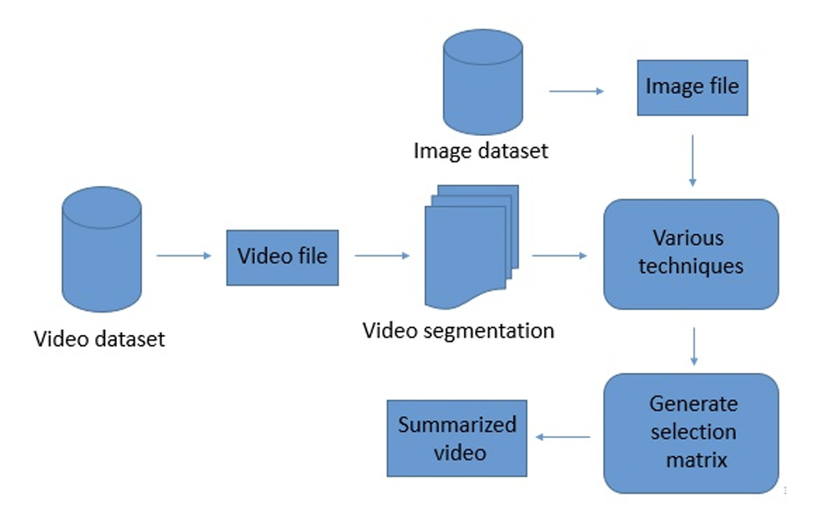
Model Architecture
[4]

Slide 13
Paper - 5
Image Conditioned Keyframe-Based Video Summarization Using Object Detection
Methodology:
Model: Utilizes YOLOv3 for object detection to identify and localize the Object of Interest (OoI) in video frames.
Approach: Summarizes videos by selecting only frames containing the OoI, reducing video length while maintaining relevant content.
Evaluation: Achieved 99.6%-99.9% accuracy on VSUMM, TVSum, and custom datasets, with metrics like precision, recall, and F1-score used for performance assessment.
Scope: Applicable in video surveillance, personal video summarization, and video content indexing, saving significant time and computational resources

Slide 14
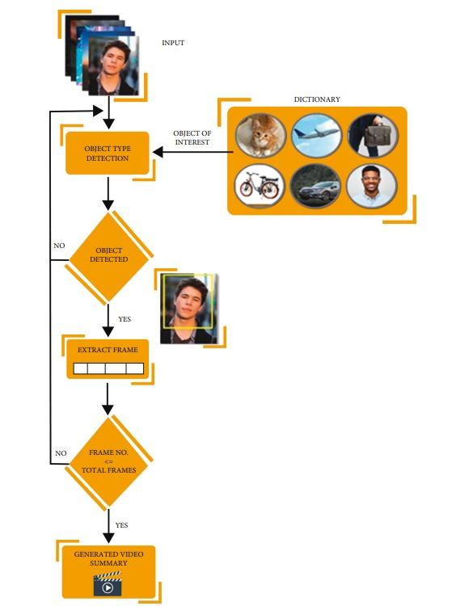
Model Architecture
[5]

Slide 15
Best Results
SumMe Dataset:
Precision: 97.8%
Recall: 91.8%
F1 Score: 94.48%
Accuracy: 98.7%
Summarization rate: 93.5%
Self-Created Dataset:
Precision: 100%
Recall: 93.1%
F1 Score: 96.2%
Accuracy: 97.5%
Summarization rate: 67.3%

Slide 16
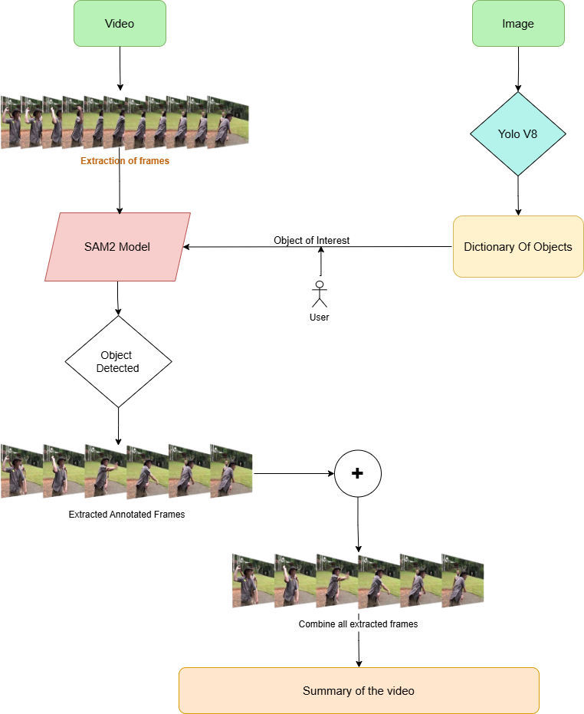
Proposed Methodology

Slide 17
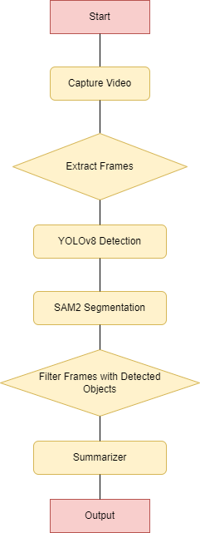
Flowchart for Video Processing Pipeline

Slide 18
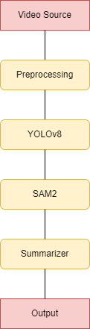
Block Diagram for System Components and Interactions

Slide 19
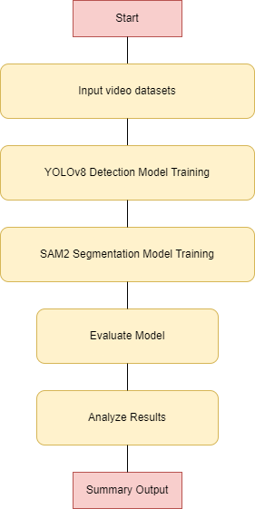
Flowchart for Model Training and Evaluation

Slide 20
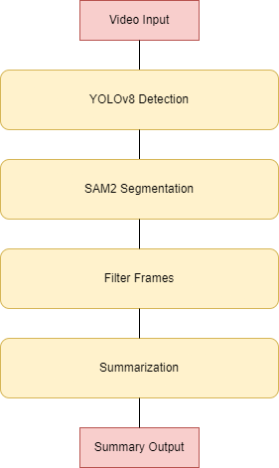
Block Diagram for Feature Extraction and Summarization

Slide 21
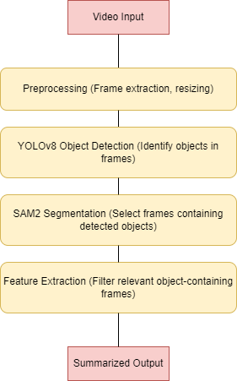
Block Diagram for System Architecture

Slide 22
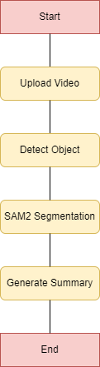
Flowchart for Video Summarizing Methodology

Slide 23
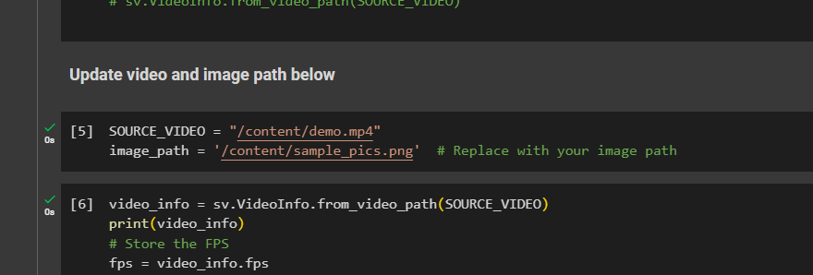
Upload Video and Picture

Slide 24
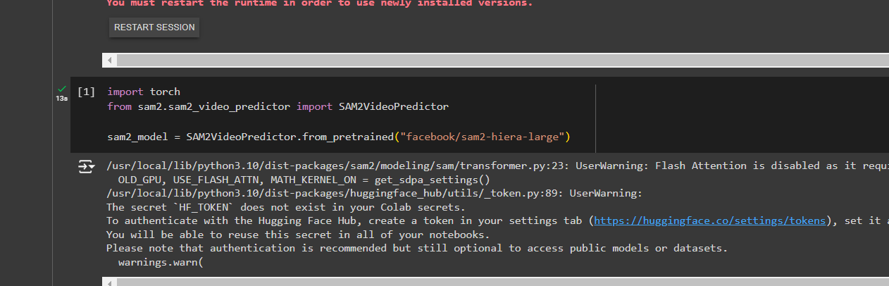
Loading model

Slide 25
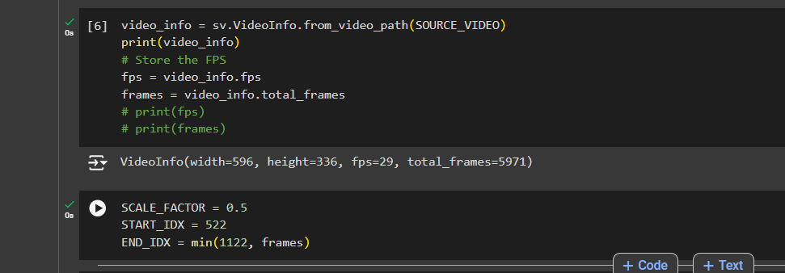
Adjust the starting and ending frame

Slide 26
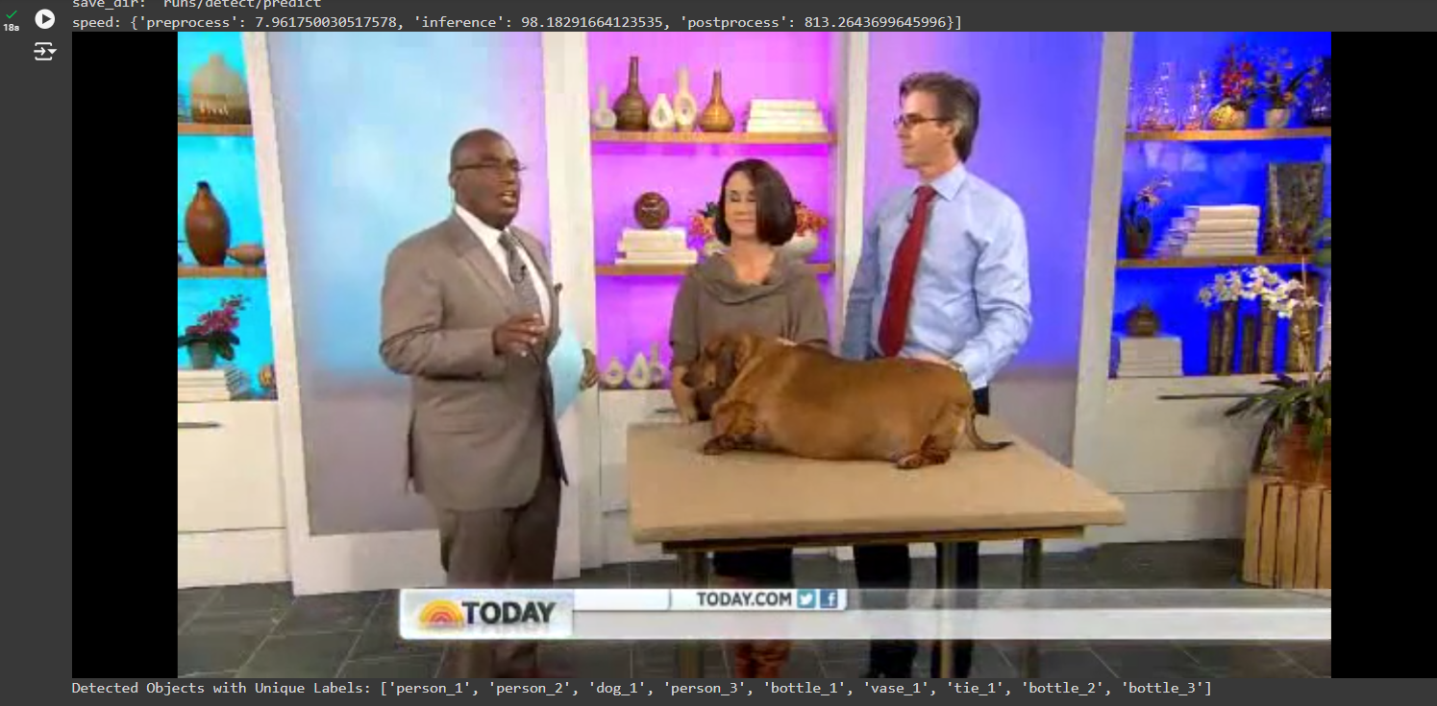
Detected Objects

Slide 27
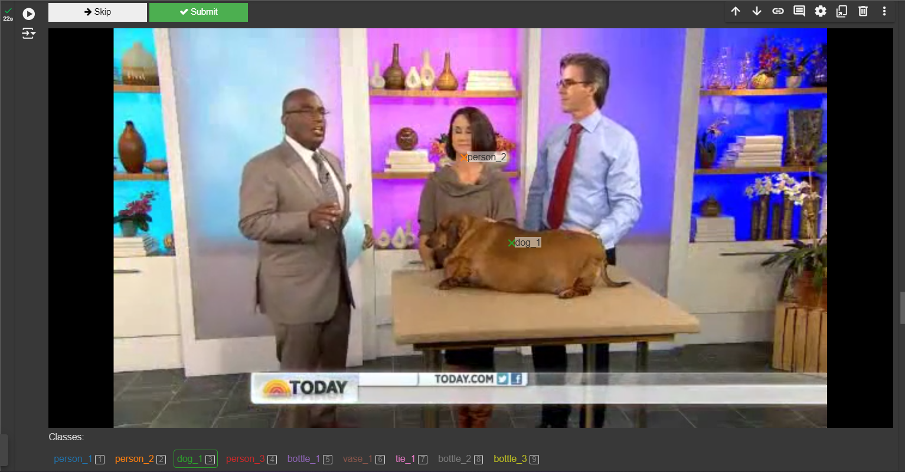
Select the objects

Slide 28

Proposed Methodology
Sample Input

Slide 29

Proposed Methodology
Sample Output

Slide 30
Proposed Methodology
1. Input Acquisition:
Description: The system takes an image and a video as input.
Purpose: The image serves as a reference for identifying the object of interest, while the video is the source from which relevant content will be summarized.
2. Object Detection (YOLOv8):
Why YOLOv8?: YOLOv8 (You Only Look Once, Version 8) is a state-of-the-art object detection model that is fast and accurate. It is capable of detecting a wide variety of everyday objects due to its training on the COCO dataset, which includes 80 different object categories.
Use in the Process :
YOLOv8 is applied to the input image to detect objects and generate a list of detected items, along with their bounding boxes and class labels.

Slide 31
Proposed Methodology
This enables the system to present the user with a selection of potential objects for summarization, making the process user-driven and flexible.
Outcome: Provides the list of detected objects for the user to choose from, setting up the next steps for targeted summarization.
3. User Selection:
Description: The user selects the desired object from the list generated by YOLOv8.
Purpose: This step allows for customization, enabling the system to focus on summarizing only the object specified by the user, rather than the entire video.
4. Object Segmentation (SAM2):
Why SAM2?: SAM2 (Segment Anything Model 2) is designed for segmentation tasks, generating high-quality masks for objects in images or video frames. It excels at segmenting objects even in challenging scenarios with complex backgrounds or overlapping objects.

Slide 32
Proposed Methodology
Use in the Process:
Once the user selects an object, SAM2 is used to identify all frames in the video that contain the selected object.
It employs a prompt-based segmentation approach to generate accurate object masks for each relevant frame, ensuring that only the selected object is considered for summarization.
Outcome: Frames containing the segmented object are identified, allowing for the extraction of content relevant to the selected object across the entire video.
5. Video Summarization:
Description: The relevant frames identified by SAM2 are combined to create a summarized version of the video.
Purpose: This step ensures that the final video contains only the segments where the selected object is present, making the summarization targeted and concise.

Slide 33
Proposed Methodology
6. Output Generation:
Description: The system generates the final summarized video.
Purpose: The summarized video serves as a concise representation of the original content, containing only the portions where the selected object appears.

Slide 34
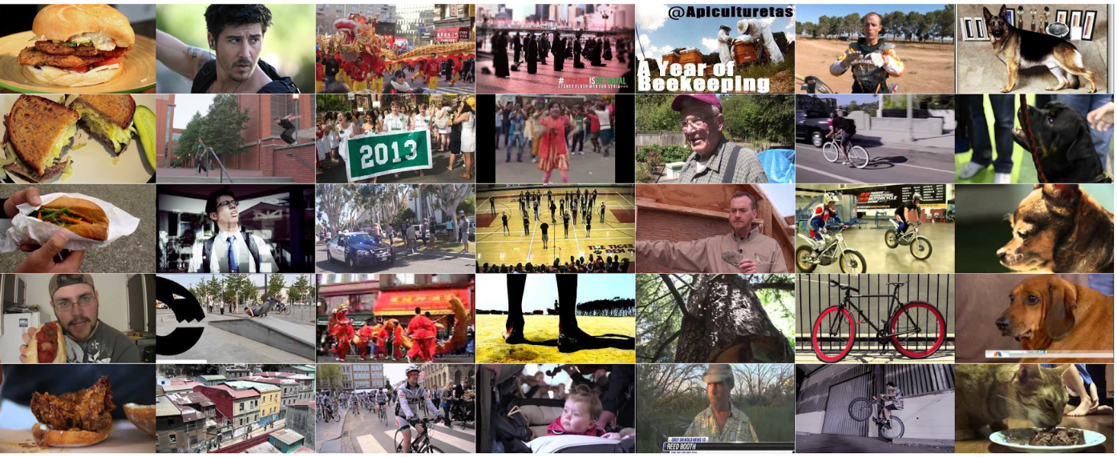
Dataset
TVSum:
50 videos from YouTube across 10 categories (e.g., news, sports, documentaries)
Videos range from 1 to 5 minutes in length
User-generated annotations for video summaries
Per-frame importance scores provided by multiple users
Covers diverse topics like cooking, how-to's, and sports
SumMe:
25 videos of varying lengths, mostly in first-person or third-person perspectives
Covers diverse real-world events and activities (e.g., holidays, sports)
User-generated ground truth summaries
Multiple annotators provide importance scores for segments
Designed for evaluating video summarization techniques in real-world settings

Slide 35
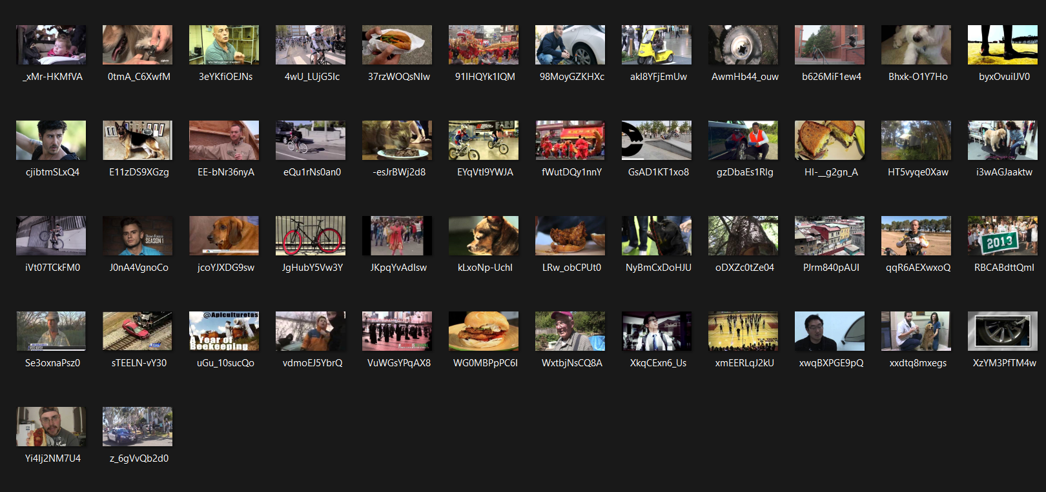
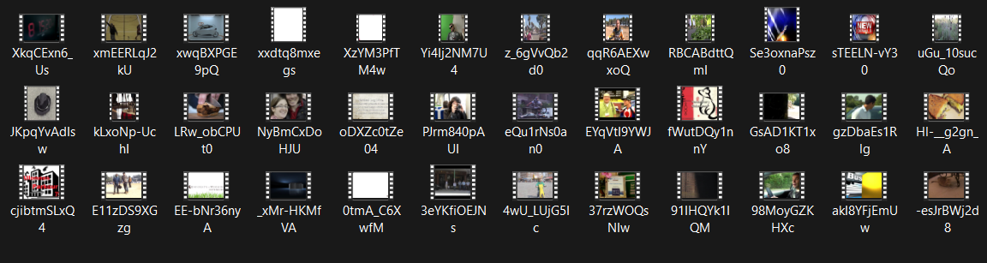
Content:-
50 YouTube videos across 10 categories
25 videos of real-world activities
Ranging from 1 to 5 minutes
Importance scores from multiple annotators

Slide 36
TVSum
1. Overview of TVSum Dataset
● Purpose: To aid the development of algorithms that can summarize videos, focusing on the diversity and relevance of the summaries.
● Creators: The dataset was introduced in the paper titled "TVSum: Summarizing web videos using titles" by Yale Song, Jordi Vallmitjana, Amanda Stent, and Alejandro Jaimes.
2. Total Videos : contains 50 videos,each of which is a user-generated video collected from YouTube having diverse themes and subjects to ensure broad applicability.
3. Categories of Videos: grouped into 10 distinct categories which are :
Changing a vehicle tire
Getting a vehicle unstuck
Grooming an animal
Making sandwiches
Parade
Flash mob gathering
Dog show
Attending a wedding ceremony
Attempting a bike trick
Packing for a trip

Slide 37
TVSum ( continued…)
4. Video Lengths:
The length of each video in the dataset varies between 1 to 6 minutes, making the total runtime of the dataset around 220 minutes .
5. Annotations:
● Frame-level importance scores: Each video is annotated with frame-level importance scores by multiple annotators. These scores indicate how important each part of the video is for generating a summary.
● Number of annotators: Each video is annotated by 20 human evaluators who assign importance scores to short segments of the videos.
● Scores: The annotators provide scores between 1 and 5, where 5 indicates high importance, and 1 indicates low importance. These scores are later averaged to form a consensus score for each segment of the video.
● Temporal segmentation: Videos are divided into 2-second segments, and annotators rate the importance of each segment.
6. Benchmarking:
● The performance is measured using metrics like Precision, Recall, and F-score.
References:
https://github.com/yalesong/tvsum
https://paperswithcode.com/dataset/tvsum-1#:~:text=Videos%20Using%20Titles-,Title%2Dbased%20Video%20Summarization%20(TVSum)%20dataset%20serves%20as%20a,crowdsourcing%20(20%20per%20video).

Slide 38
SumMe
The SumMe dataset is a widely used dataset for video summarization, often utilized alongside the TVSum dataset.
1. Overview of SumMe Dataset:
Purpose: The SumMe dataset is designed for evaluating video summarization algorithms by providing user-generated videos along with multiple human-created summaries. The goal is to generate concise summaries that capture the essential content of the videos.
Creators: Introduced in the paper "Category-specific video summarization" by D. Gygli, H. Grabner, H. Riemenschneider, and L. Van Gool.
2. Total Videos:The dataset contains 25 videos, which are user-generated and span a wide variety of real-world events.
3. Categories and Content of Videos:
● Sports activities
● Travel vlogs
● Events (e.g., parades, weddings)
● Daily activities (e.g., cooking, hiking)
● Outdoors and nature scenes
● Personal experiences at tourist locations

Slide 39
SumMe(Continued…)
4. Video Lengths: The length of videos in the SumMe dataset varies, typically ranging from 1 to 6 minutes. The total runtime of all videos combined is approximately 66 minutes.
5. Annotations: Each of the 25 videos in the SumMe dataset is annotated with a minimum of 15 human-generated summaries, amounting to a total of 390 summaries. Key points about the annotations include:
● Human-created summaries: Summaries are manually created by annotators, who select key moments they find important, resulting in a concise summary of 15-20% of the video length.
● Variability: Since each summary reflects the preferences of individual annotators, the dataset includes a high degree of variability.
● Frame-level ground truth: The dataset provides selected frames as ground truth, allowing these frames to be used for generating video summaries.
6. Evaluation Metrics: F1 score, Precision and Recall,ROUGE

Slide 40
SumMe(Continued…)
7. Comparison with TVSum Dataset:
● Summarization Approach: SumMe provides manual summaries created by users, while TVSum assigns frame-level importance scores. This makes SumMe summaries more subjective, reflecting individual preferences.
● Number of Videos: SumMe has 25 videos, whereas TVSum contains 50 videos, making TVSum a larger dataset.
● Categories: TVSum organizes its videos into 10 categories, while SumMe covers a broader range of real-life activities without strict categorization.
References:
https://paperswithcode.com/dataset/summe#:~:text=The%20SumMe%20dataset%20is%20a,summaries%20(390%20in%20total).
https://github.com/robi56/video-summarization-resources?tab=readme-ov-file

Slide 41
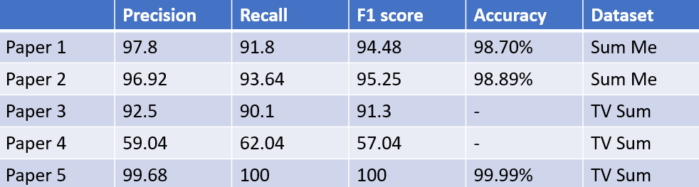
Results from papers:

Slide 42
TimeLine
Research and Literature Review
Model Development
Final Model Optimization
(mid Aug - mid Sep)
(mid Oct)
(Starting Nov - current)
(July - mid Aug)
(mid Sep - mid Oct)
(End Oct)
Dataset Collection and Preprocessing
Model Training and Evaluation
Documentation and Reporting

Slide 43
References
Haq, H. B. U., Suwansantisuk, W., & Chamnongthai, K. An optimized deep learning method for video summarization based on the user object of interest. King Mongkut’s University of Technology Thonburi (KMUTT)
Habiba Yasser Adel , Ramez M. Elmasry ,Mohammed A.-M.Salem “Object-Based Video Archive Summarization” Media Engineering and Technology German University in Cairo Cairo, Egypt
Alok Negi , Krishan Kumar (SMIEEE MACM) , Parul Saini , Shamal Kashid “Object Detection based Approach for an Efficient Video Summarization with System Statistics over Cloud” Department of Computer Science and Engineering National Institute of Technology Uttarakhand Srinagar, India
Hafiz Burhan Ul Haq, Muhammad Asif and Toqeer Mahmood,”Image Conditioned Keyframe-Based Video Summarization Using Object Detection” Faculty of Computer Science, Lahore Garrison University, Lahore, Pakistan ,College of Computing and Information Science, Karachi Institute of Economics and Technology, Karachi, Pakistan Faculty of Computer Science, National Textile University, Faisalabad, Pakistan respectively.

Slide 44
5 . Neeraj Baghel , Suresh C. Raikwar , Charul Bhatnagar “Image Conditioned Keyframe-Based
Video Summarization Using Object Detection” .

